Slide 1


Design And Implementation Of
Duplicate File Detection System
Presented by: Monish L [1972260035]
Jeevan Shine D [1965260019]
CSA0307 - Data Structure
Date: 29/10/2026

Slide 2
Introduction
The project uses data structures in C, a hash table and linked lists, to detect duplicate files stored in a folder.
Duplicate copies waste disk space, and finding them by hand or by comparing every pair of files is slow and unreliable.
Purpose of the project is to automate duplicate detection with fast, content-based comparison that ignores file names.

Slide 3
Objectives
Scan a folder and all its sub-folders, and index every file by its size and content hash.
Use a hash table with chaining for fast lookup, and linked lists to group the paths of duplicate files.
Identify duplicates by content, not by name, and verify each match byte by byte to avoid false positives.
Report the duplicate sets and the reclaimable disk space so the user can clean up safely.

Slide 4
Literature Review
S.NO | RESEARCH PAPER | AUTHOR | ADVANTAGES | DISADVANTAGES | TECHNOLOGIES USED
1 | File Duplicate Detector System Using Hashing Algorithm (2013) | Danny G. Umoso | Finds same-content files even when names differ | Hashing alone is crude because of its simplicity | Hashing algorithm
2 | Duplicate File Analyzer using N-layer Hash and Hash Table (2017) | S. Mukherjee et al. | O(n) comparison with a hash table; better collision resistance | Several hashes per file add overhead | SHA-256, MD5, hash table
3 | Web-scale Content Reuse Detection (2014) | C. Ardi, J. Heidemann | Efficient reuse detection on very large collections | Whole-file hashing misses partial copies | Cryptographic hashing, fingerprinting

Slide 5
Methodology
Programming language used : ANSI C (C99 standard)
Compiler & environment : GCC (GNU Compiler Collection), Visual Studio Code
Data structures used : Hash table with chaining, singly linked list, recursion
Algorithm : FNV-1a 64-bit content hash, then byte-by-byte verification
Input : Folder path from the command line; files read in binary mode (read-only)

Slide 6
















System Architecture Design
User
Select Folder
File System
Hash Table
Compute Hash
Linked List Chain
Display Result
Verify & Group Duplicates
Duplicate Groups List

Slide 7








Module 1: File Scanning & Hash Indexing
User
Scan Summary Report
File Scanner & Indexer Module
Directory Traversal
Hash Computation
File Index (Hash Table)
Select Folder Path
Hash Table Insert
Byte-by-Byte Check

Slide 8
Module 2 : Duplicate Detection & Cleanup Management
User (CLI)
Report Generator
Byte-by-Byte Verifier
Detection Engine
Cleanup Manager
Duplicate Groups Store
Hash Table + Chains

Slide 9
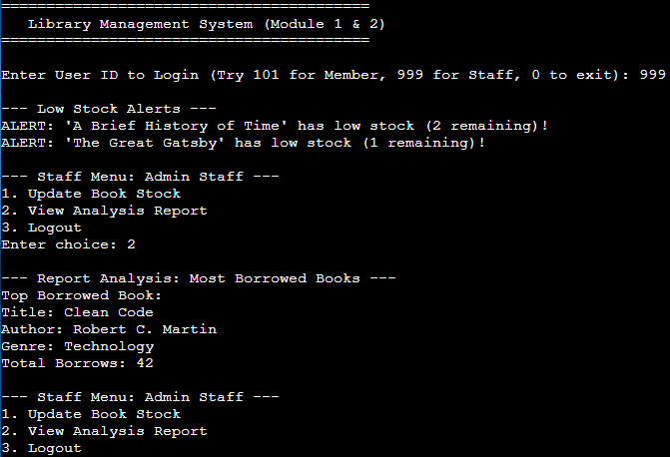
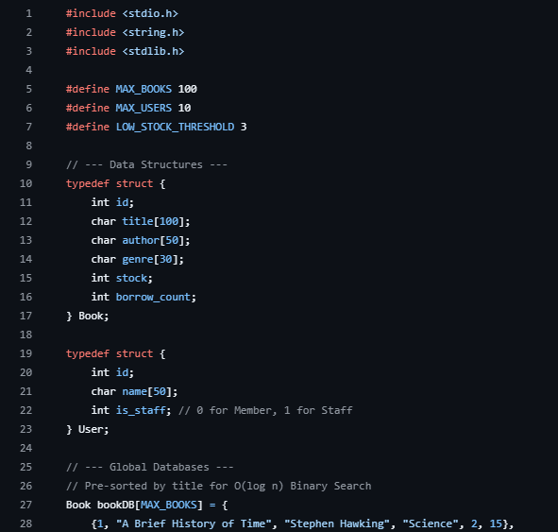
Implementation – Module 1
File Scanning & Hash Indexing
typedef struct Entry {
unsigned long long hash;
long size;
PathNode *paths;
int count;
struct Entry *next;
} Entry;
static unsigned long long fnv1a(const char *p, long *size) {
FILE *f = fopen(p, "rb");
unsigned long long h = 14695981039346656037ULL;
unsigned char buf[4096];
size_t n, i;
*size = 0;
if (!f) return 0;
while ((n = fread(buf, 1, sizeof buf, f)) > 0) {
for (i = 0; i < n; i++) {
h ^= buf[i];
h *= 1099511628211ULL;
}
*size += (long)n;
}
fclose(f);
return h;
}
$ find testdir -type f | sort
testdir/backup/b.txt
testdir/backup/img1_backup.bin
testdir/backup/notes_copy.txt
testdir/backup/report_old.txt
testdir/docs/a.txt
testdir/docs/notes.txt
testdir/docs/report.txt
testdir/docs/report_v2.txt
testdir/photos/img1.bin
testdir/photos/renamed_notes.dat
$ ./dfd testdir
Scanning: testdir
...
Files scanned : 10

Slide 10
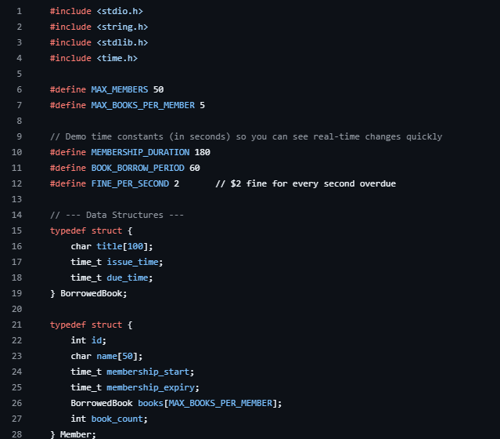
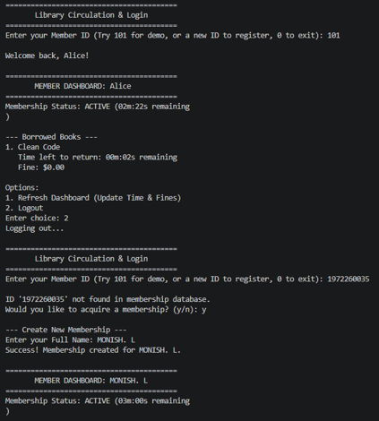
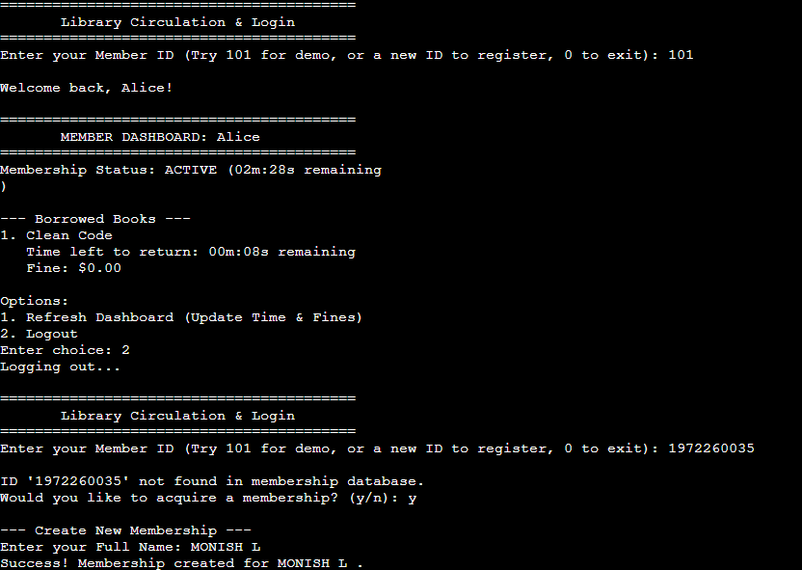
Implementation – Module 2
Duplicate Detection & Cleanup Management
static void insert(const char *path) {
long size;
unsigned long long h = fnv1a(path, &size);
unsigned idx = (unsigned)(h % BUCKETS);
Entry *e;
files_scanned++;
for (e = table[idx]; e; e = e->next)
if (e->hash == h && e->size == size &&
same_bytes(e->paths->path, path)) {
add_path(e, path);
wasted += size;
return;
}
e = calloc(1, sizeof *e);
e->hash = h; e->size = size;
e->next = table[idx]; table[idx] = e;
add_path(e, path);
}
static int same_bytes(const char *a, const char *b) {
FILE *fa = fopen(a, "rb"), *fb = fopen(b, "rb");
int ok = (fa && fb), ca, cb;
while (ok && (ca = fgetc(fa)) != EOF) {
cb = fgetc(fb);
if (ca != cb) ok = 0;
}
if (ok && fgetc(fb) != EOF) ok = 0;
if (fa) fclose(fa);
if (fb) fclose(fb);
return ok;
}
$ ./dfd testdir
Scanning: testdir
Group 1 (49 bytes, 3 copies)
[KEEP] testdir/backup/notes_copy.txt
[DUP] testdir/docs/notes.txt
[DUP] testdir/photos/renamed_notes.dat
Group 2 (25 bytes, 2 copies)
[KEEP] testdir/backup/report_old.txt
[DUP] testdir/docs/report.txt
Group 3 (20000 bytes, 2 copies)
[KEEP] testdir/backup/img1_backup.bin
[DUP] testdir/photos/img1.bin
Files scanned : 10
Duplicate sets : 3
Duplicate files : 4
Space reclaimable: 20123 bytes

Slide 11
Results & Discussion
Detection accuracy: On a 10-file test folder the system found all 3 duplicate sets (4 duplicate files), including a renamed copy, with no false positive on a near-identical file.
Search efficiency: The hash table gives O(1) average lookup per file, replacing O(n²) pairwise comparison.
Safety: Byte-by-byte verification after a hash match rules out collisions; 20,123 bytes were reported as reclaimable.

Slide 12
Challenges & Limitations
Read cost: Every file must be read in full to compute its hash, so scanning very large folders is slow.
Collision handling: A 64-bit FNV-1a hash is not cryptographic and can collide, so a second byte-by-byte pass is needed.
Exact match only: Files that differ by even one byte are treated as different, and the tool runs single-threaded.

Slide 13
Future Scope
Stronger hashing: Add N-layer hashing with SHA-256 and MD5 for higher collision resistance, as in the literature.
Near-duplicate detection: Use chunk-level or fuzzy hashing to find similar files, not only identical ones.
Safe cleanup & GUI: Add a graphical interface, a move-to-recycle option, multi-threaded scanning and a resizable hash table.

Slide 14
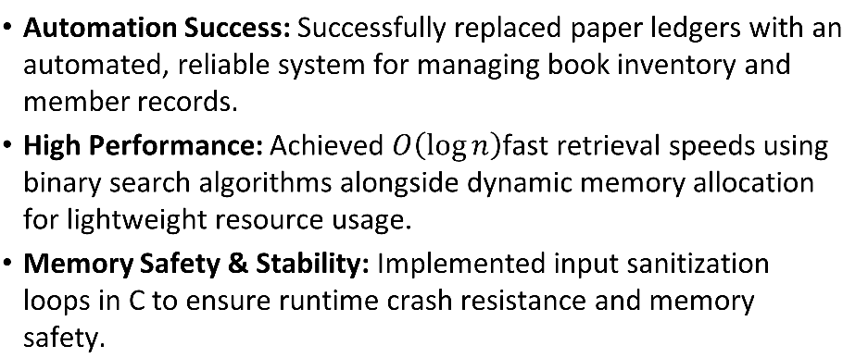
Conclusion
Automation success: Replaced slow manual searching with an automated system that finds duplicate files by content.
Efficient design: A hash table with chaining and linked lists gave fast lookups and neat grouping of duplicate paths.
Reliable results: Byte-by-byte verification keeps the report free of false positives, and files are only read, never changed.

Slide 15
References
D. G. Umoso, "Development of a File Duplicate Detector System Using Hashing Algorithm," International Journal on Social Innovation & Research, vol. 6, no. 1, 2013.
S. Mukherjee et al., "Duplicate File Analyzer using N-layer Hash and Hash Table," International Research Journal of Computer Science (IRJCS), vol. 4, no. 6, Jun. 2017.
C. Ardi and J. Heidemann, "Web-scale Content Reuse Detection (extended)," USC/ISI Technical Report ISI-TR-692, Jun. 2014.

Slide 16
Thank You!
Any Questions?

